Slide 1
Appointment Scheduling Dataset Analysis
Presented by: Kerwin Pham

Slide 2


Overview of Dataset
Dataset contains information of patients, appointment and requesting dates, and provider roles
Objective: To provide recommendations based on average wait time using data analysis
Importance of Wait Times
An effective health care system utilizes timely access as well as availability
Longer wait times are associated with poor health outcomes
Wait times are needed to be minimized to improve patient experience
Wait times can be reduced through effective management

Slide 3

Data Preparation
Prepared Data with Power Query:
Split days and hours using delimiter
Added Average wait time in days
Added Maximum wait times in days
Added Minimum wait times in days

Slide 4
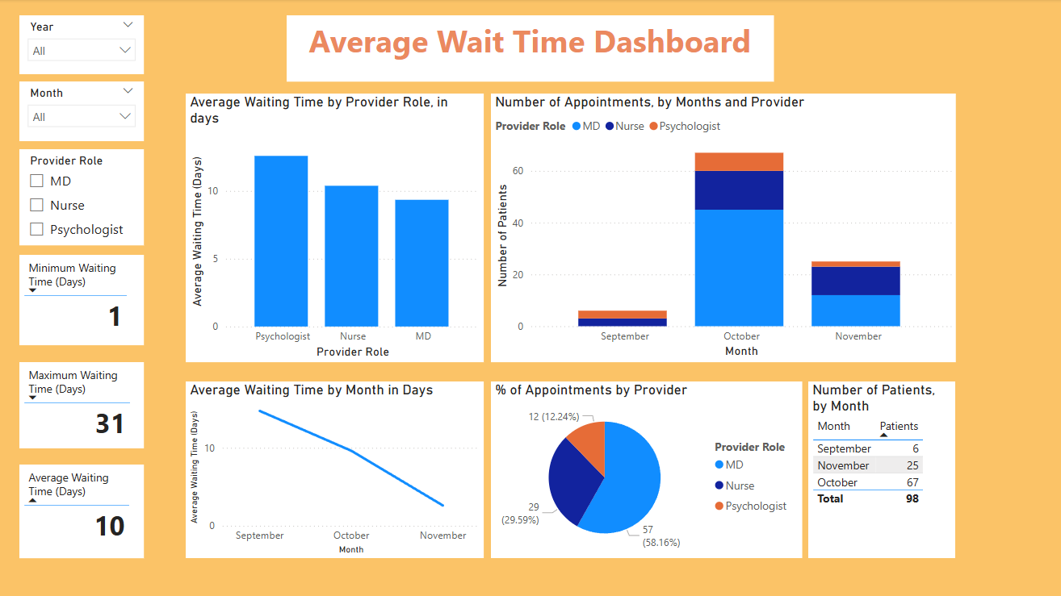

Slide 5
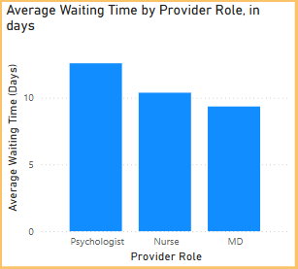
Observations
1 Nurses and Psychologists have the highest waiting times since request date
2 MDs have the lowest average wait times
3 Hiring additional Nurses and Psychologists is suggested for reduced burden

Slide 6


Recommendations
Addressing highest wait times:
On average, Psychologists and Nurses have the highest wait times
Additional staffing, funding, or equipment can elevate efficiency in services
Addressing high number of patients:
MDs have the highest number of patients, so they may need more staffing
Highest priority is to staff more Psychologists and Nurses, but once wait times increase for MDs, there should be more staffing in the category as well.
Data Quality Improvement areas:
More options for data identification such as gender, location, and age of patients.

